Slide 1
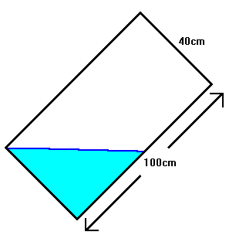
George and Phil were playing with their fish tank again. They had a difficult time keeping their fish alive. The fish tank is 100cm long, 60 cm wide and 40 cm high. They tilted the tank, as shown, resting on a 60 cm edge, with the water level reaching the midpoint of the base. When they rest the tank down to a horizontal position, what is the depth of the water in cm?
Problem
9th grade math problem

Slide 2
Do You Want A Hint?
Volume

Slide 3
Depth of the water

Slide 4
Think in …

