Slide 1
Venn Diagrams
By: Samantha DeLorenzo

Slide 2
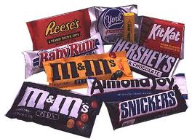
Materials
3 Circle Venn-diagrams
Variety of Chocolate

Slide 3
Anticipatory Set…
33 Chocolate
10 Chocolate with Caramel
14 Chocolate with Peanuts
6 that have all three
How many pieces of candy are their?

Slide 4
Goals…
Student will learn to organize data accordingly.
Student will learn how to interpret data that is given on a Venn diagram.

Slide 5
Objectives…
Given a three circle Venn-diagram the student will record data accurately with 100% accuracy.
Given a three circle Venn-diagram that is filled in with data, the student will be able to answer questions correctly with 100% accuracy based on the given information.

Slide 6
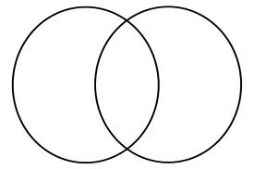
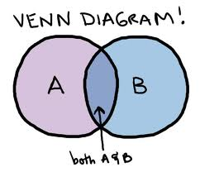
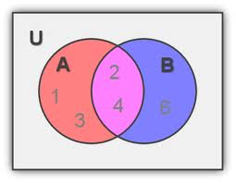
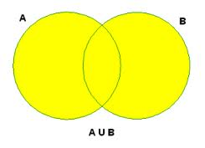
Definitions
Venn Diagram- a diagram that uses circles to represent sets and their relationships.
Intersection- consists of all elements in both A and B.
Universe- gives us the set of elements being considered (everything inside and outside A and B)
Union-everything in either A and B

Slide 7
Procedure:
Each student will be given a Venn-diagram and directed to label it appropriately.
Each student will grab 3 pieces of candy.
Students will then put each piece of candy in the necessary part of the Venn-diagram.
After, they are finished they will come to the board and put tally marks in each part of the diagram that matches their Venn-diagram.
Then, as a class we will look over the Venn-diagram and observe what we see and answer questions.

Slide 8
Fill in your Venn Diagrams with your candy then come to front and put a tally in each appropriate circle to match your Venn diagram.

Slide 9
As a class we should have…
15
Chocolate
Peanuts
8
6
4
So, there are 33 pieces of candy.
Caramel

Slide 10
Questions…
How many people have chosen both chocolate and chocolate with peanuts?
How many people chose all three (chocolate peanuts and caramel)?

Slide 11
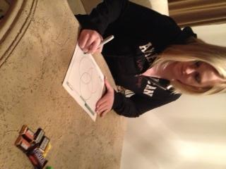
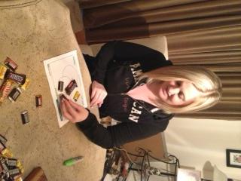
Higher Level thinking Problem:
A person is given a bunch of different varieties of candy. 9 pieces can be distributed throughout chocolate, chocolate and peanuts, and chocolate peanuts and caramel. Also, 11 pieces could be distributed between chocolate, chocolate and caramel, and chocolate peanuts and caramel. Two pieces belong in the chocolate caramel and peanuts section. How many pieces of candy are their?
Labeling her Venn diagram
Filling in her Venn diagram based on the information given in the problem

Slide 12
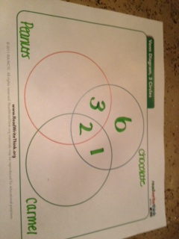
Solution…
There are a total of12 pieces of candy.

